Slide 1
Pivoting From Manager To Leader
11/5/2021
Notes:
TELL

Slide 2
Have You Ever Wondered…
Why are all these employees so happy?
How does that cafeteria run more successfully than mine?
How are so many of their employees promoting and mine aren’t?

Slide 3
What Could It Be?
It could be the leadership the employees are gaining from their manager.

Slide 4
Manager
Leader
A manager guides and directs people to get results.
A leader does not make commands, they inspire, encourage, and care about the team.
Experience
Communication
Delegation
Reliability
Knowledge
Inspiring
Confidence
Time Management
Organization
Respect for Staff
Notes:
TELL:
Understand the difference between management and leadership
Describe what operational excellence is. Know the topic, quote books, motivational speakers, etc.
Ask questions of why they think it is important.

Slide 5
Pivoting From Manager To Leader
The main goal is to help you improve your leadership skills.
To pivot is to change the direction and do something different then we did before.
The way you pivot will make all the difference.

Slide 6
What Is Leadership?
Leadership is the ability to cultivate a strong work environment using recognized principles together with hard and soft management skills.
To transition from manager to leader we must continuously work to improve our leadership skills.
Notes:
TELL:
Generate a discussion with participants.
Describe what operational excellence is. Know the topic, quote books, motivational speakers, etc.
Ask questions of why they think it is important.

Slide 7
What Are Soft and Hard Skills?
Skills are the tools we use to achieve our goals. Cafeteria staff should apply a mix of soft and hard skills to be fully productive.
Soft Skills
Hard Skills
Personality traits that make you a good employee.
Teachable and measurable abilities specific to a job.
Soft skills are rooted in our behavior, attitude and values. They are characteristics that you already possess or can learn.
Hard skills are job-specific abilities or knowledge learned through education, experience, or training. They are technical skills needed to perform a certain job.

Slide 8
Soft Skills
Communication: Easily communicate messages with clarity.
Teamwork & Respect: Put the best interest of the team above all else.
Problem-Solving & Critical Thinking: Take immediate, logical actions to solve issues

Slide 9
Soft Skills
Time Management & Organization: Prioritize and organize the workspace, time, and workload.
Motivation & Work Ethic: Disciplined, focused, and always professional.
Leadership: Does not make commands, they inspire, encourage, and care about the team.

Slide 10
Soft Skills
Flexibility & Creativity: Adapt to new environments and challenges and come up with fresh solutions and ideas.
Emotional Intelligence: Interpret, comprehend and manage the emotions of themselves and others.

Slide 11
Hard Skills
Hard skills are job-specific abilities or knowledge learned through education, experience, or training. They are technical skills needed to perform a certain job.
Cashier Skills
Budgeting
Language Skills
Email Writing
Data Analysis
Culinary Skills
Computer Skills
Social Media

Slide 12
Leadership Principles
Pivoting toward applying these principles in your operation will lead to a cohesive environment where employees and customers will want to return every day.
Respect Every Individual
Lead By Humility
Focus on Processes
Workplace Culture
Mentorship
Notes:
TELL:
Generate a discussion with participants.
Describe what operational excellence is. Know the topic, quote books, motivational speakers, etc.
Ask questions of why they think it is important.

Slide 13
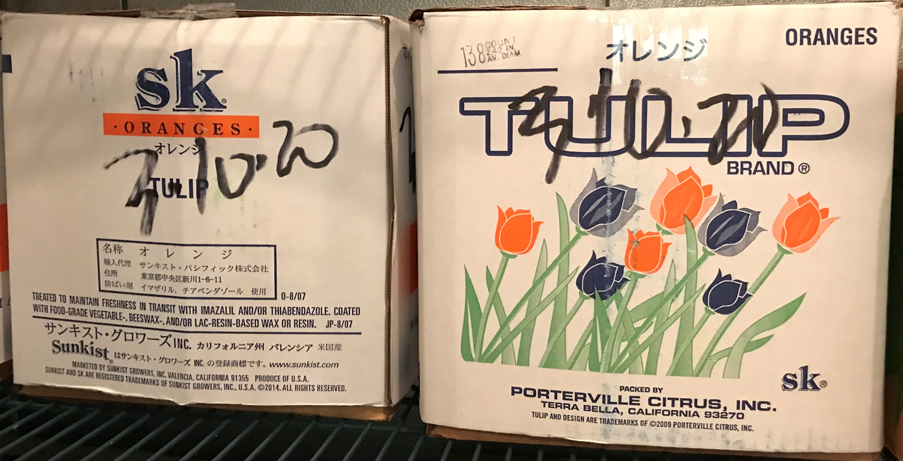
Respect Every Individual
All staff members deserve respect. You can show respect by involving staff in cafeteria improvements. They will feel motivated to contribute in a positive way.
Thank you!
I find it works better like that.
That’s a great idea! I think it will work, let’s try it.
Notes:
TELL:
Generate a discussion with participants.
Describe what operational excellence is. Know the topic, quote books, motivational speakers, etc.
Ask questions of why they think it is important.

Slide 14
Respect Every Individual
Be Courteous
Listen Attentively
Treat Everyone Equal
Include Staff In Decisions
Notes:
TELL: Describe how product quality must meet such need to fulfill demand
Generate a discussion with participants.
Describe what operational excellence is. Know the topic, quote books, motivational speakers, etc.
Ask questions of why they think it is important.

Slide 15
Respect Every Individual
Be Courteous
No matter who you’re speaking to or what kind of day you’re having good manners are a constant must. Be kind regarding others’ needs and opinions.
Notes:
TELL: Describe how product quality must meet such need to fulfill demand
Generate a discussion with participants.
Describe what operational excellence is. Know the topic, quote books, motivational speakers, etc.
Ask questions of why they think it is important.

Slide 16
Respect Every Individual
Listen Attentively
Successful and respectful communication is a two-way street, when having a conversation, take time to attentively listen and actively hear others.
Notes:
TELL: Describe how product quality must meet such need to fulfill demand
Generate a discussion with participants.
Describe what operational excellence is. Know the topic, quote books, motivational speakers, etc.
Ask questions of why they think it is important.

Slide 17
Respect Every Individual
Treat Everyone Equal
Treat everyone you interact with fairly and equally to maintain a positive workplace.
Notes:
TELL: Describe how product quality must meet such need to fulfill demand
Generate a discussion with participants.
Describe what operational excellence is. Know the topic, quote books, motivational speakers, etc.
Ask questions of why they think it is important.

Slide 18
Respect Every Individual
Include Staff In Decisions
Different ideas, perspectives and backgrounds are what make a workplace multifaceted. Empower staff to participate in cafeteria changes by utilizing their ideas and recognize their contributions.
Notes:
TELL: Describe how product quality must meet such need to fulfill demand
Generate a discussion with participants.
Describe what operational excellence is. Know the topic, quote books, motivational speakers, etc.
Ask questions of why they think it is important.

Slide 19
Lead By Humility
When we lead by humility we are willing to show our shortcomings and receive suggestions from cafeteria staff.
When I wrap burgers I am not very fast, you are really good at it.
Can you show me how to do it your way?
Thank you for noticing and I will be happy to show you.
Notes:
TELL:
Generate a discussion with participants.
Describe what operational excellence is. Know the topic, quote books, motivational speakers, etc.
Ask questions of why they think it is important.

Slide 20
Lead By Humility
Humility gives you the ability to see the “big picture” and recognize that each person has their own individual strengths. Humility is not thinking less of yourself but thinking of yourself less.
Ask themselves “How can I improve?”
Take suggestions from staff
Look for solutions that benefit everyone
Give credit where it is due
Lead by actions not words
Notes:
TELL: Describe how product quality must meet such need to fulfill demand
Generate a discussion with participants.
Describe what operational excellence is. Know the topic, quote books, motivational speakers, etc.
Ask questions of why they think it is important.

Slide 21
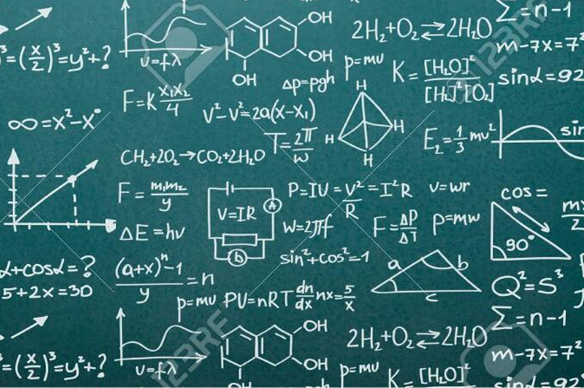
Focus On Processes
A process is a series of actions taken to achieve a specific result. Even the best employee will struggle with a bad process.
High-5 Method
Don’t Overcriticize
Offer Encouragement
Talk To, Not About
Notes:
TELL:
Generate a discussion with participants.
Describe what operational excellence is. Know the topic, quote books, motivational speakers, etc.
Ask questions of why they think it is important.

Slide 22
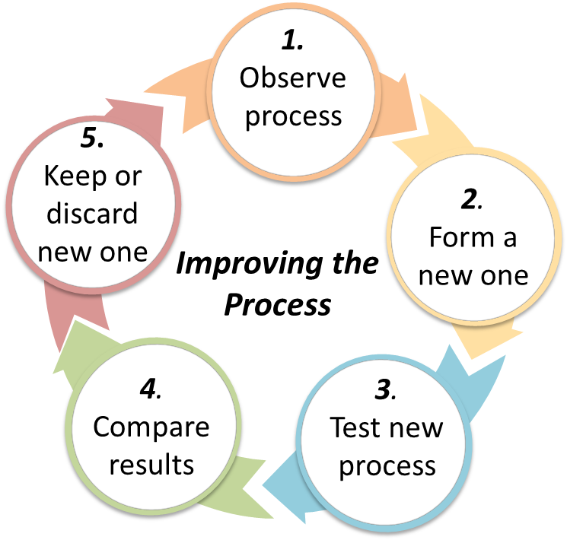
Focus On Processes
The High-5 Method
Follow the high-5 method to improve the process.
Simplify work without affecting the quality
Notes:
TELL: Describe how product quality must meet such need to fulfill demand
Generate a discussion with participants.
Describe what operational excellence is. Know the topic, quote books, motivational speakers, etc.
Ask questions of why they think it is important.

Slide 23
Skills
Focus On Processes
Notes:
TELL: Describe how product quality must meet such need to fulfill demand
Generate a discussion with participants.
Describe what operational excellence is. Know the topic, quote books, motivational speakers, etc.
Ask questions of why they think it is important.

Slide 24
Skills
Focus On Processes
When things go wrong avoid “the blame game” and designate a process that will prevent future mistakes.
Notes:
TELL: Describe how product quality must meet such need to fulfill demand
Generate a discussion with participants.
Describe what operational excellence is. Know the topic, quote books, motivational speakers, etc.
Ask questions of why they think it is important.

Slide 25
Skills
Focus On Processes
Don’t Overcriticize
Nit-picking, belittling, patronizing or constantly criticizing will only discourage others and damage your relationship. When leading a team, it’s important to provide constructive feedback and mention what they could do differently to grow.
Notes:
TELL: Describe how product quality must meet such need to fulfill demand
Generate a discussion with participants.
Describe what operational excellence is. Know the topic, quote books, motivational speakers, etc.
Ask questions of why they think it is important.

Slide 26
Skills
Focus On Processes
Offer Encouragement
Offer constant positive reinforcement along with constructive comments to give your team the confidence and encouragement they need to feel good about their daily accomplishments.
Notes:
TELL: Describe how product quality must meet such need to fulfill demand
Generate a discussion with participants.
Describe what operational excellence is. Know the topic, quote books, motivational speakers, etc.
Ask questions of why they think it is important.

Slide 27
Skills
Focus On Processes
Talk To, Not About
If you take issue with a person or situation, the best way to address the problem is head-on. Discuss the situation directly with the person in a constructive and respectful manner.

Slide 28
Skills
Workplace Culture
Workplace Culture
Build Valued Customers
Avoid Negativity
Positive Work Environment
Motivate Staff
Notes:
TELL:
Define customer needs , wants and demands
Expectations are created by experiences and knowledge of products.
Generate a discussion with participants.
Describe what operational excellence is. Know the topic, quote books, motivational speakers, etc.
Ask questions of why they think it is important.

Slide 29
Skills
Workplace Culture
Workplace Culture
Keep in mind, the atmosphere inside the cafeteria transfers to student perspective of the cafeteria. We create a welcoming environment that encourages customers to return.
Notes:
TELL:
Define customer needs , wants and demands
Expectations are created by experiences and knowledge of products.
Generate a discussion with participants.
Describe what operational excellence is. Know the topic, quote books, motivational speakers, etc.
Ask questions of why they think it is important.

Slide 30
Skills
Workplace Culture
Workplace Culture
Build Valued Customers
A business that stops valuing their customers is not sustainable over time.
Hi, how was your breakfast today?
Good, I really like the French toast.
Thank you!
Understand customer’s expectations
Deliver upon those expectations
Obtain feedback
Measure and improve customer service
Notes:
TELL: Describe how product quality must meet such need to fulfill demand
Generate a discussion with participants.
Describe what operational excellence is. Know the topic, quote books, motivational speakers, etc.
Ask questions of why they think it is important.

Slide 31
Skills
Workplace Culture
Workplace Culture
Build Valued Customers
Notes:
TELL: Describe how product quality must meet such need to fulfill demand
Generate a discussion with participants.
Describe what operational excellence is. Know the topic, quote books, motivational speakers, etc.
Ask questions of why they think it is important.

Slide 32
Skills
Workplace Culture
Workplace Culture
Avoid Negativity
Research has shown that poor leadership can negatively impact employees’ motivation levels and productivity –creating an unpleasant work environment.
Notes:
TELL: Describe how product quality must meet such need to fulfill demand
Generate a discussion with participants.
Describe what operational excellence is. Know the topic, quote books, motivational speakers, etc.
Ask questions of why they think it is important.

Slide 33
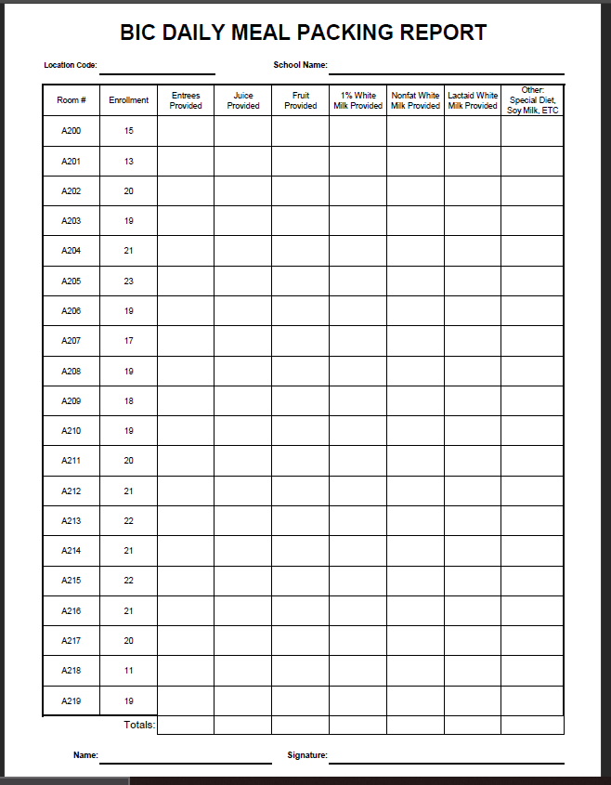
Skills
Workplace Culture
Workplace Culture
When our work environment is filled with negativity, it will show in the service we provide.
Avoid Negativity
Do I have to do everything myself?
The oven temperature was set at 500.
500
I burned the hamburgers!
350
Notes:
TELL:
Generate a discussion with participants.
Describe what operational excellence is. Know the topic, quote books, motivational speakers, etc.
Ask questions of why they think it is important.

Slide 34
Skills
Workplace Culture
Workplace Culture
Avoid Negativity
Mistakes happen, but how we respond to them can create a negative environment.
None of you ever do it right.
500
350
Notes:
TELL:
Generate a discussion with participants.
Describe what operational excellence is. Know the topic, quote books, motivational speakers, etc.
Ask questions of why they think it is important.

Slide 35
Skills
Workplace Culture
Workplace Culture
Positive Work Environment
Discussion:
What do you do to create a positive work environment?

Slide 36
Skills
Workplace Culture
Workplace Culture
When cafeteria staff enjoy their work environment this will have a direct correlation to customer satisfaction.
Positive Work Environment
350
350
Notes:
TELL:
Generate a discussion with participants.
Describe what operational excellence is. Know the topic, quote books, motivational speakers, etc.
Ask questions of why they think it is important.

Slide 37
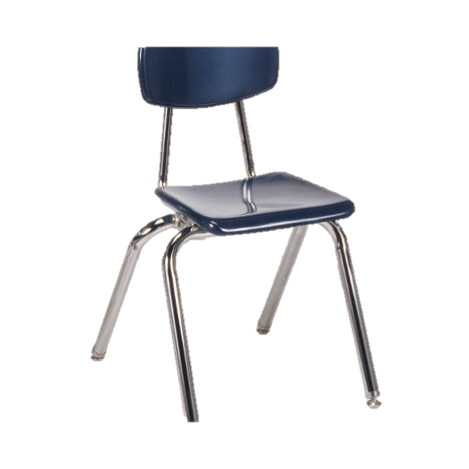
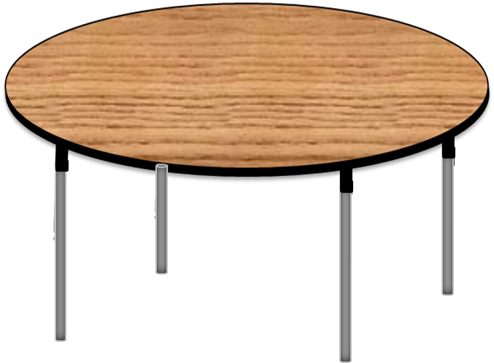
Happy Birthday to you!
I hear the buzzer on the oven.
Thanks Jason, I will cut a piece of cake for you.
Enjoy your birthday cake, I’ll check the food.
Would you rather be a part of this team?

Slide 38
Skills
Workplace Culture
Workplace Culture
Motivate Staff
Employees who are seen and heard feel valued and as a result are more motivated.
Create a positive environment
Practice effective communication
Understand your staff’s individual differences
Recognize positive behavior and achievements
Encourage staff to step out of their comfort zone

Slide 39
Skills
Workplace Culture
Mentoring
Mentoring As A Leader
Personal Pay Off
Paving The Way
Pay It Forward
Continue The Loop
Notes:
TELL:
Generate a discussion with participants.
Describe what operational excellence is. Know the topic, quote books, motivational speakers, etc.
Ask questions of why they think it is important.

Slide 40
Skills
Workplace Culture
Mentoring
Mentoring focuses on the growth and development of a person. A mentor will give another person the benefit of his or her years of experience and/or education.
Mentee will develop skills and abilities
Benefits both parties, the Mentor and Mentee; as well as the organization
Enhances work life, commitment and job satisfaction
Organization
Notes:
TELL:
Generate a discussion with participants.
Describe what operational excellence is. Know the topic, quote books, motivational speakers, etc.
Ask questions of why they think it is important.

Slide 41
Skills
Workplace Culture
Mentoring
Both parties must be willing to put in the work in order for the mentorship to be successful.
The following criteria can be determined at the start:
PROCESS
LOGISTICS
BOUNDARIES
ASSUMED
RESPONSIBILITIES
TIME
COMMITMENT
GOALS
DEALING
WITH CONFLICTS
Notes:
TELL:
Generate a discussion with participants.
Describe what operational excellence is. Know the topic, quote books, motivational speakers, etc.
Ask questions of why they think it is important.

Slide 42
Skills
Workplace Culture
Mentoring
Mentoring As A Leader
GOALS
Determine clear understanding of achievable goals
ASSUMED
RESPONSIBILITIES
Agree on a scope of responsibilities for each person
TIME
COMMITMENT
Both parties must agree on scheduled time set aside for mentorship
Notes:
TELL:
Generate a discussion with participants.
Describe what operational excellence is. Know the topic, quote books, motivational speakers, etc.
Ask questions of why they think it is important.

Slide 43
Skills
Workplace Culture
Mentoring
Mentoring As A Leader
PROCESS
LOGISTICS
How, when, and where meetings and communications will take place
Discuss any topics or issues that are outside the mentoring boundaries
BOUNDARIES
Situations may arise and you will need to come up with workable solutions
DEALING
WITH CONFLICTS
Notes:
TELL:
Generate a discussion with participants.
Describe what operational excellence is. Know the topic, quote books, motivational speakers, etc.
Ask questions of why they think it is important.

Slide 44
Skills
Workplace Culture
Mentoring
Ask yourself…
”What do I gain from a mentorship?”
Personal Pay Off
A mentor/mentee relationship that is mutually satisfying
Learn new things about myself
Expanding my network contacts
Learn to be a stronger leader by developing exceptional interpersonal skills
Assist in staying current with issues and developments in the next generation of professionals
Build confidence in myself and others
Notes:
TELL:
Generate a discussion with participants.
Describe what operational excellence is. Know the topic, quote books, motivational speakers, etc.
Ask questions of why they think it is important.

Slide 45
Skills
Workplace Culture
Mentoring
Prepare yourself to understand that mentoring eventually ends. You have shared all you can and/or the mentee has learned all he or she can.
Paving The Way
Thank you for your mentorship!
I wish you the best of luck!
Notes:
TELL:
Generate a discussion with participants.
Describe what operational excellence is. Know the topic, quote books, motivational speakers, etc.
Ask questions of why they think it is important.

Slide 46
Skills
Workplace Culture
Mentoring
Pay It Forward
The mentee can decide for themselves if they want to take on a mentorship as well. They will use the wisdom and knowledge their mentor taught them and pass it on to another less experienced employee willing to learn.
Notes:
TELL:
Generate a discussion with participants.
Describe what operational excellence is. Know the topic, quote books, motivational speakers, etc.
Ask questions of why they think it is important.

Slide 47
Skills
Workplace Culture
Mentoring
Continue The Loop
Mentorship is a rewarding act of kindness. The feeling of assisting others in their personal growth can inspire and reignite your passion for your job. Continue to mentor others for as long as it stays rewarding for you.
Notes:
TELL:
Generate a discussion with participants.
Describe what operational excellence is. Know the topic, quote books, motivational speakers, etc.
Ask questions of why they think it is important.

Slide 48
The Leader Inside You
Every operation needs a good leader who can guide…
With respect, we listen to employees before responding.
By humility, we ask ourselves “How can I improve?”
Through focusing on the process, we simplify work without affecting quality.
By building on workplace culture, we form an environment where employees and customers will want to return every day.
Through mentorship, we can use our knowledge to pave the way for new leaders.
Notes:
TELL:
Generate a discussion with participants.
Describe what operational excellence is. Know the topic, quote books, motivational speakers, etc.
Ask questions of why they think it is important.

Slide 49
Who Are You?
Leader
Inspires enthusiasm
Says “we”
Encourages
Develops people
Takes responsibility
Listens more
Focuses on strengths
Coaches and mentors
Says “Let’s go”
Gives credit
Notes:
TELL:
Understand the difference between management and leadership
Describe what operational excellence is. Know the topic, quote books, motivational speakers, etc.
Ask questions of why they think it is important.

